Slide 1
STL Allocator + Mem Pool

Slide 2
STL Allocator Interface
An Example – allocator as a template parameter
template < class T, class Alloc = allocator<T> > class vector;
template < class T, class Alloc = allocator<T> > class list;

Slide 3
STL Allocator Interface
What does an allocator have? ( xmemory0 )
Member types:
typedef void _Not_user_specialized;
typedef _Ty value_type;
typedef value_type *pointer;
typedef const value_type *const_pointer;
typedef value_type& reference;
typedef const value_type& const_reference;
typedef size_t size_type;
typedef ptrdiff_t difference_type;
typedef true_type propagate_on_container_move_assignment;
typedef true_type is_always_equal;
Member function:
pointer address(reference _Val) const _NOEXCEPT
const_pointer address(const_reference _Val) const _NOEXCEPT
void deallocate(pointer _Ptr, size_type _Count)
_DECLSPEC_ALLOCATOR pointer allocate(size_type _Count)
template<class _Uty> void destroy(_Uty *_Ptr)
template<class _Objty,
class... _Types>
void construct(_Objty *_Ptr, _Types&&... _Args)

Slide 4
STL Allocator Interface
An example code
namespace JJ
{
template <class T>
inline T* _allocate(ptrdiff_t size, T*) {
T *tmp = (T*)(::operator new((size_t)(size*sizeof(Y)));
if (tmp == 0) {
cerr << "out of memory"<< endl;
exit(1);
}
return tmp;
}
template <class T>
inline void _deallocate(T *buffer) {
::operator delete(buffer);
}
…………………

Slide 5
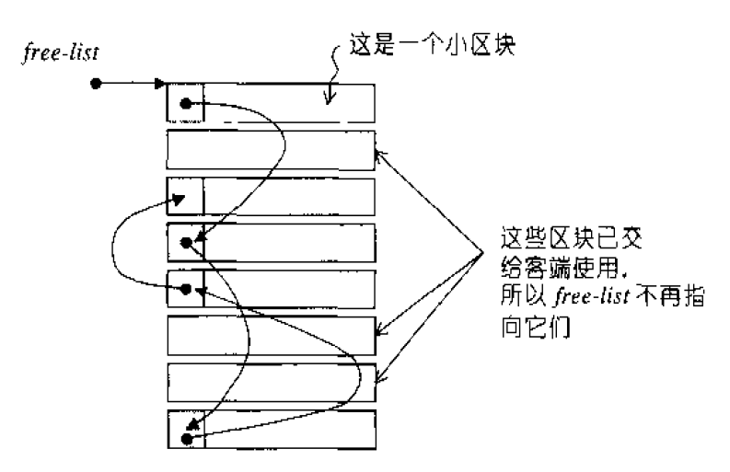
Mem pool
Speed up of a larger number of dynamic memory allocation
An example: Mem pool using block based allocation strategy

Slide 6
Howework
Task
Implement an allocator with mem-pool to support std::vector
Test the ability of the allocator with 10000 times of various size of vector construction and destruction (use random value)

Slide 7
Requirement
Implement an memory allocator for STL vector and list. The interface for the allocator is in the xmemory0 file.
The allocator should optimize memory allocation speed using memory pool
The allocator should support arbitrary memory size allocation request.

Slide 8
How to test your allocator
First, create more than ten thousand vectors with different number of elements
Second, pick up 1000 random vectors and resize the vectors with random size
Third, release all vectors

Slide 9
How to specify the vector size, type through a file
// to create vectors
//number of vectors to be created
int // an integer vector with 10 elements
Float //a float vector with 34 elements
…………….
// to create lists //number of lists to be created
100 //number of lists to be created
int // an integer list with 10 elements
Float //a float float with 34 elements
int // an integer vector with 10 elements
Float //a float vector with 34 elements
…………….
//random resize
23 30 //random vector index new vector size
56 78
1345 1000
6700 2000
You can write a program
to generate this file to test your allocator
I will give you a file to test your allocator performance

